Slide 1


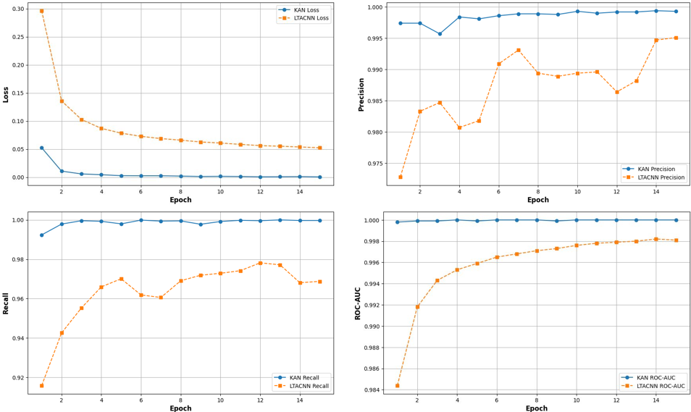
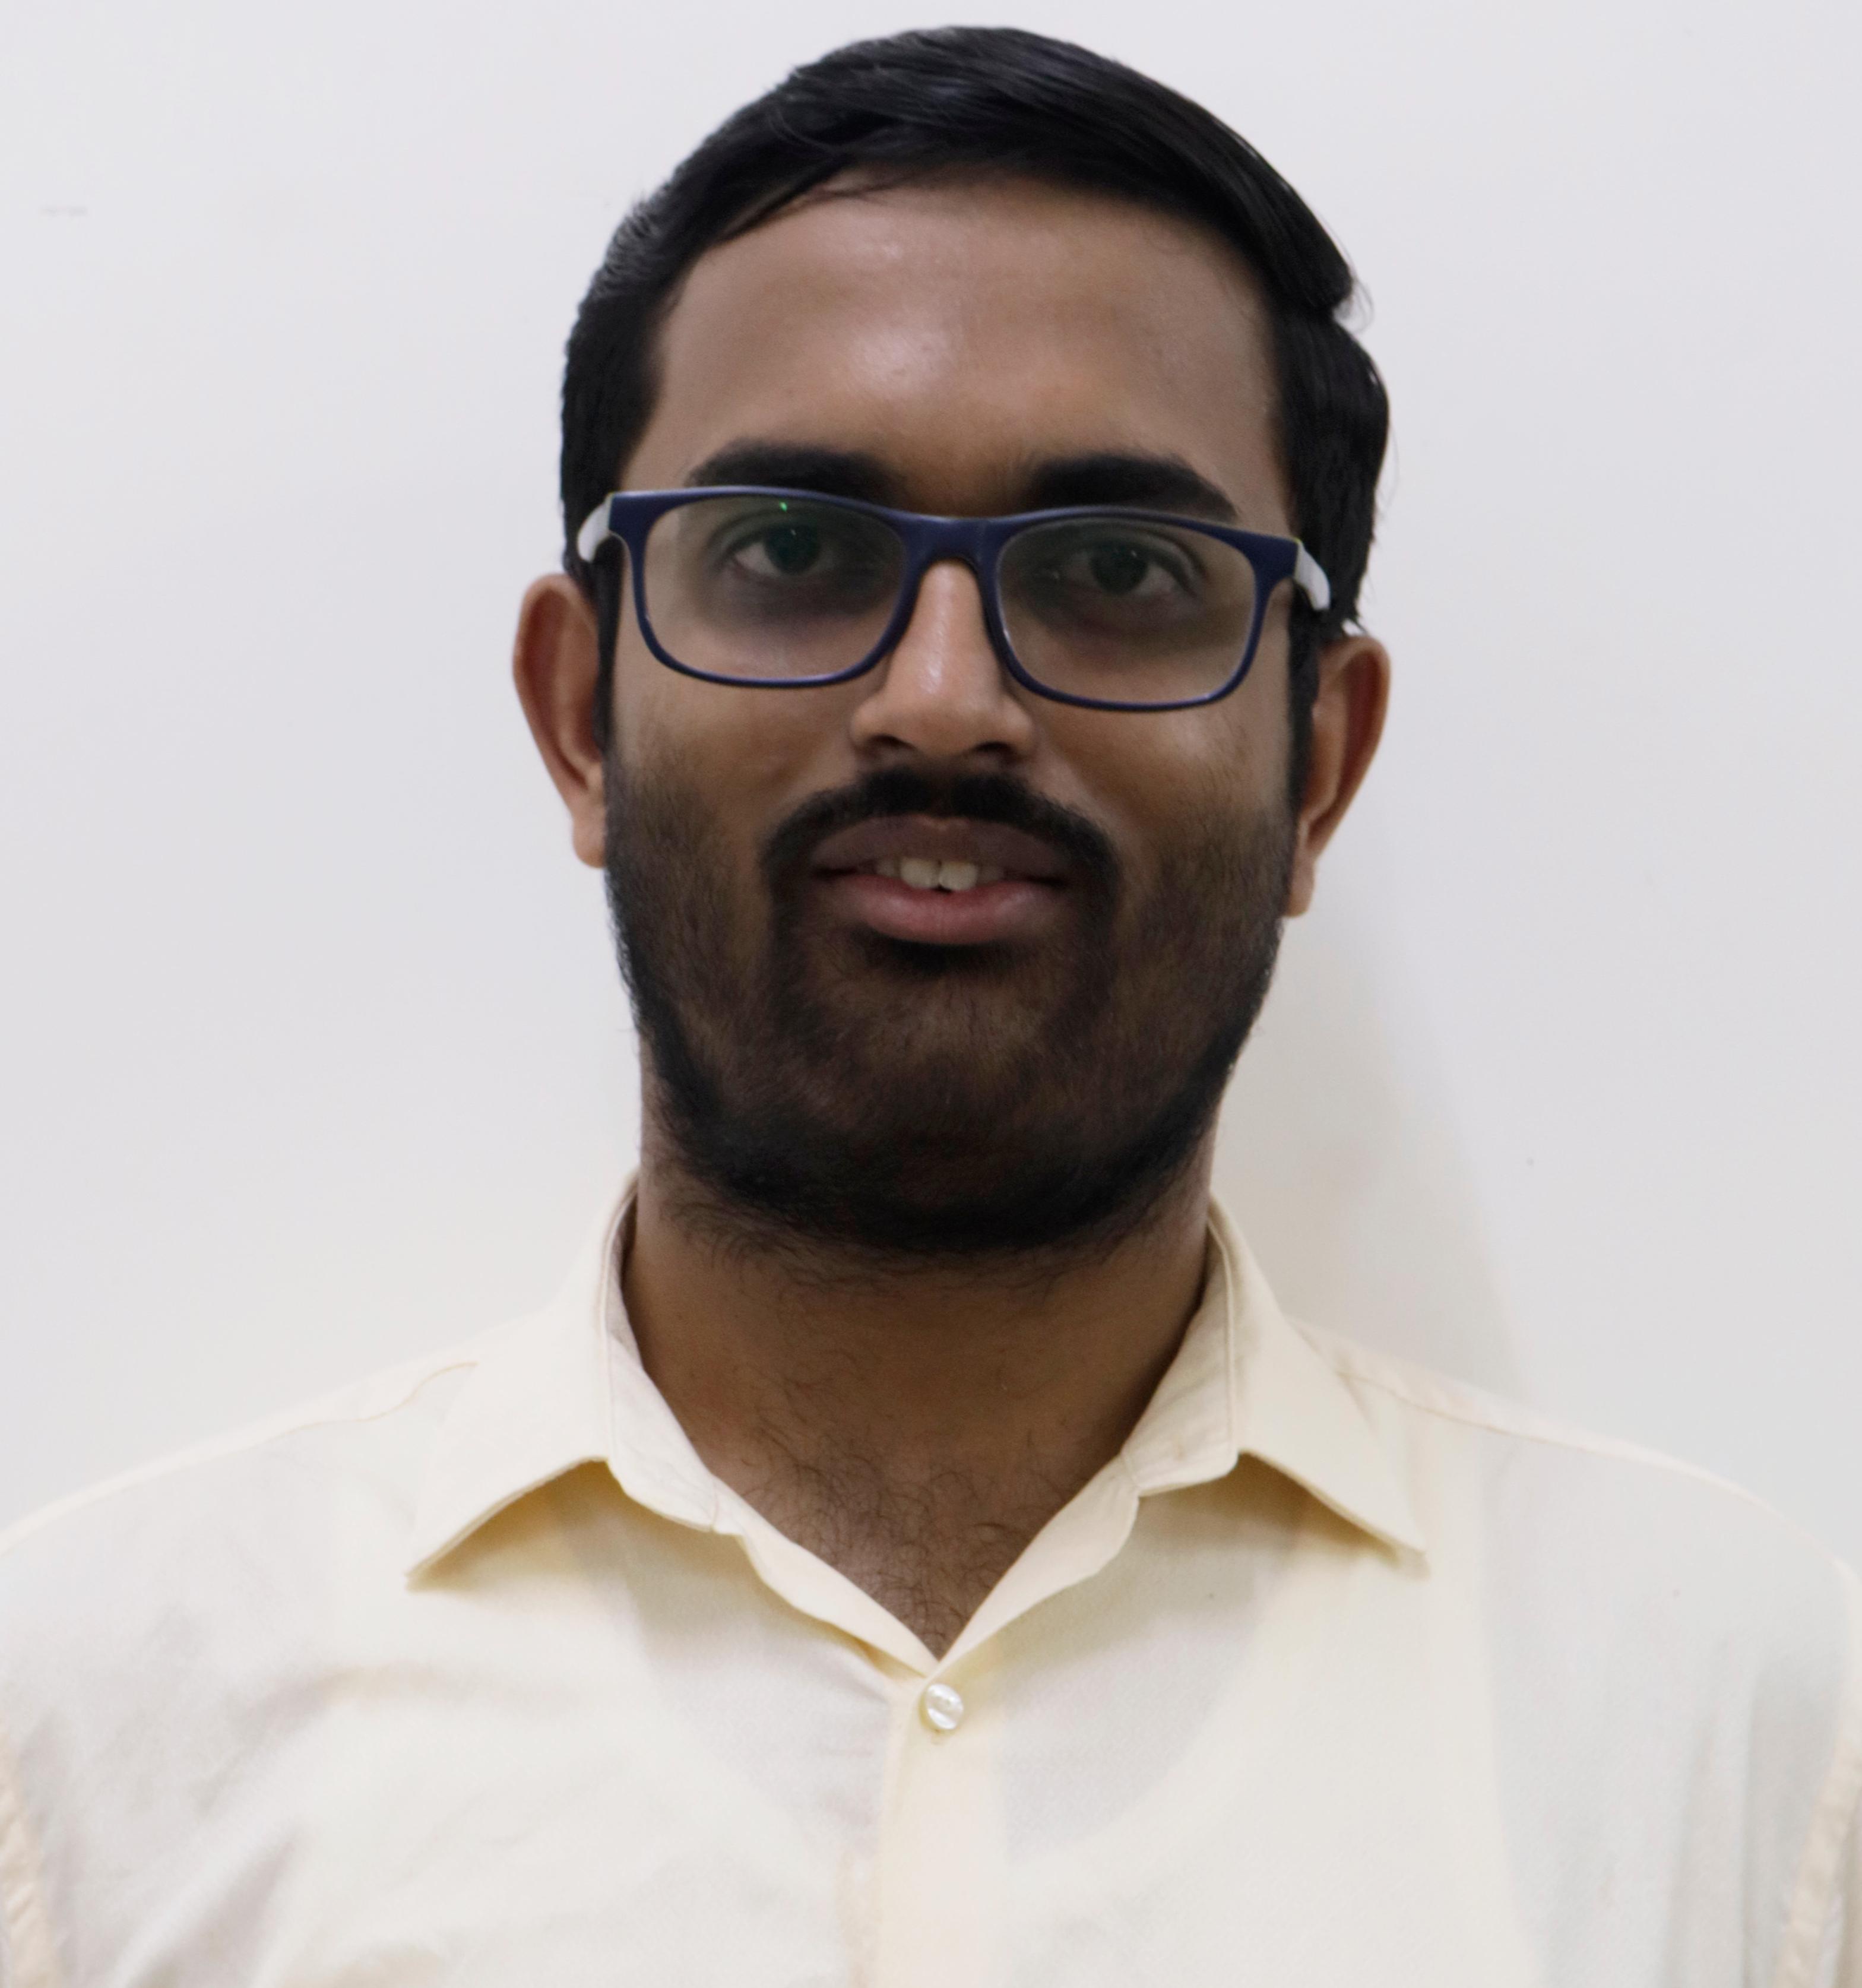
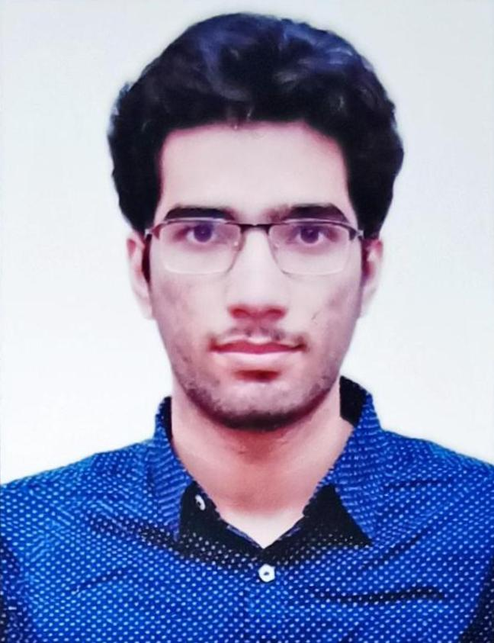
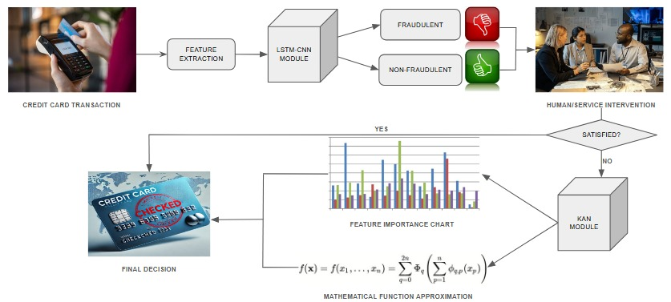
TRANSPARENT CREDIT CARD FRAUD DETECTION
Saksham Sharma-21BAI1223 Sushant Gargi - 21BRS1072
Dr.Suganeshwari G
School of Computer Science and Engineering
MOTIVATION / INTRODUCTION
Credit card fraud remains a critical concern, demanding sophisticated detection. A major challenge lies in balancing high accuracy with model transparency, essential for financial applications.
Deep learning models excel in accuracy but often function as "black boxes," limiting trust and regulatory acceptance.
Traditional interpretable models may struggle to capture the complex, evolving patterns in modern transaction data.
This research introduces a novel framework integrating a high-performance Linear Time Attention CNN (LTACNN) with an inherently interpretable Kolmogorov-Arnold Network (KAN).
The LTACNN uses CNNs, LSTMs, and linear attention for robust pattern recognition and accurate detection.
The KAN complements this by providing transparency, elucidating the LTACNN's decision process via mathematical functions and feature importance scores.
This research delivers a robust, accurate, and interpretable fraud detection model, addressing key limitations in current approaches.
OBJECTIVES
Develop a novel LTACNN-KAN framework combining high accuracy with interpretability for credit card fraud detection.
Evaluate framework performance using standard metrics (Accuracy, Precision, Recall, ROC-AUC) on benchmark datasets.
Utilize KAN to generate transparent mathematical functions and feature importance scores explaining LTACNN predictions.
Compare the KAN-based approach against the LTACNN baseline to quantify performance and explainability improvements.
Validate the consistency and reliability of the generated interpretations using SHAP and LIME analysis across models.
SCOPE OF THE PROJECT
This project scopes the design, implementation, and evaluation of a novel LTACNN-KAN framework for interpretable credit card fraud detection. It covers preprocessing imbalanced data (ADASYN, Scaling), training/evaluating LTACNN/KAN models (Accuracy, ROC-AUC), and analyzing interpretability (SHAP/LIME), demonstrating enhanced accuracy with transparency for financial applications.
METHODOLOGY
Preprocessing:
Imbalance Handling: Applied ADASYN (Adaptive Synthetic Sampling) to oversample the minority (fraud) class in the dataset, creating a balanced training set.
Feature Scaling: Utilized RobustScaler to scale transaction features, minimizing the impact of outliers common in financial data.
Data Preparation: Converted data into PyTorch tensors suitable for deep learning model input, including appropriate dimensionality for CNN/LSTM layers.
Model Development & Training:
LTACNN Model: Developed a hybrid model using 1D CNNs (local patterns), LSTMs (temporal sequences), and a custom Linear Attention mechanism (efficient feature weighting).
KAN Model: Implemented a KAN using the pykan library to serve as an interpretable layer, trained to approximate the LTACNN's decision function.
Training: Employed PyTorch framework with Adam optimizer and Binary Cross-Entropy Loss for training both models on GPU.
Evaluation & Interpretability:
Metrics: Assessed models using Accuracy, Precision, Recall, F1-Score, and ROC-AUC.
Analysis: Utilized SHAP and LIME techniques to analyze and compare feature importance derived from both LTACNN and KAN models. Wilcoxon signed-rank test used for statistical comparison.
ARCHITECTURE
RESULTS
CONCLUSION
KAN achieved higher accuracy and faster convergence than LTACNN. Both models identified similar key features, ensuring consistency. KAN provided clear, interpretable outputs with strong performance.
CONTACT DETAILS
Sushant Gargi Saksham Sharma
sushant.gargi2021@vitstudent.ac.in saksham.sharma2021@vitstudent.ac.in
7488225462 9773539749
REFERENCES
Z. Liu, Y. Wang, S. Vaidya, F. Ruehle, J. Halverson, M. Soljačić,T. Y. Hou, and M. Tegmark, "KAN: Kolmogorov–Arnold Networks," in Proc. of the International Conference on Learning Representations (ICLR), 2025, [Online]. Available: ref https://arxiv.org/abs/2404.19756.
I. Benchaji, S. Douzi, B. El Ouahidi, and J. Jaafari, "Enhanced credit card fraud detection based on attention mechanism and LSTM deep model", Journal of Big Data, vol. 8, article 151, 2021, doi: 10.1186/s40537-021-00541-8.
Algorithm | Accuracy | Precision | Recall
LSTM-CNN-ATTENTION | 0.9434 | 0.9880 | 0.9782
KAN-APPROX | 0.9234 | 0.9790 | 0.9701

